Slide 1
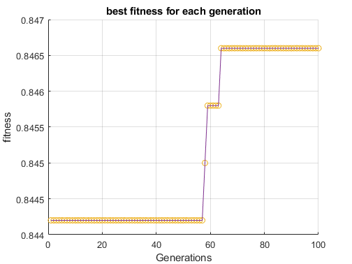
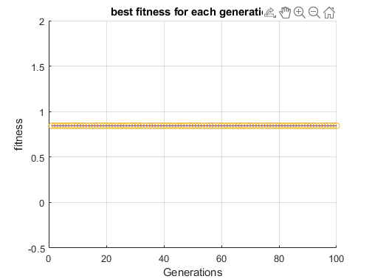
Mutation rate = 0.1
Changes 10% of a weight or bias if triggered
Parents = 2
100 generations
10 models
Looks at the best model of each generation (since the best model doesn’t change throughout generations that’s why there are these steps
Mutation rate = 0.05
Changes 10% of a weight or bias if triggered
Parents = 2
100 generations
10 models
Mutation rate too low

Slide 2
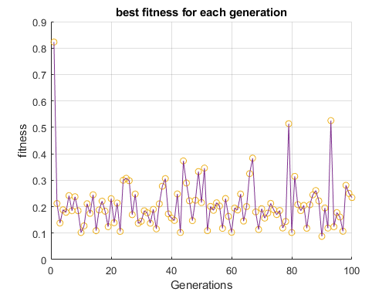
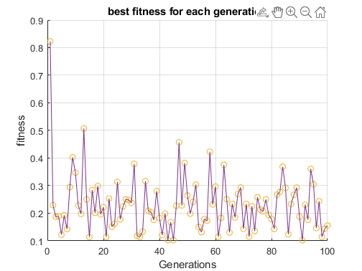
Mutation rate = 0.15
Looking at the median fitness. Normally converges so weird output
Everything else besides mutation rate is the same
Mutation rate = 0.12
Looking at the median fitness. Normally converges so weird output
Everything else besides mutation rate is the same
Both failed

Slide 3
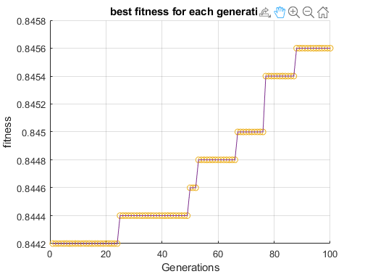
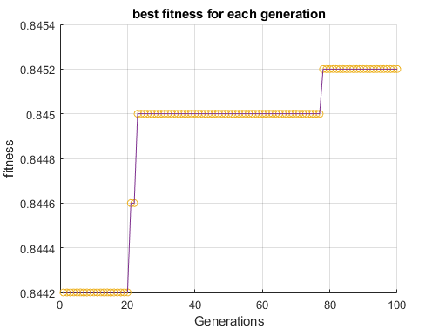
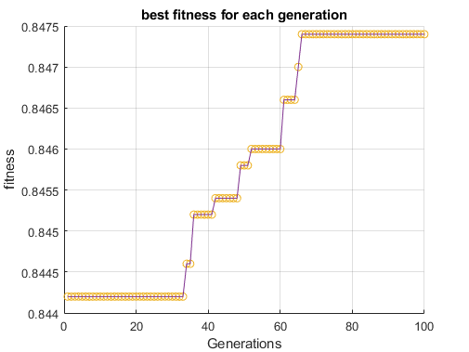
Can try to mess with amount mutated
Mutation rate = 0.11
Amount muted = 20%
100 generations
2 parents
Much better !!!
Looks like amount muted makes a big difference (maybe we make this dynamic?)
Mutation rate = 0.11
Amount muted = 10%
100 generations
2 parents
Seems this one has won
Mutation rate = 0.11
Amount muted = 30%
100 generations
2 parents
Mutation rate = 0.11
Amount muted = 50%
100 generations
2 parents
Was wayyy to slow

Slide 4
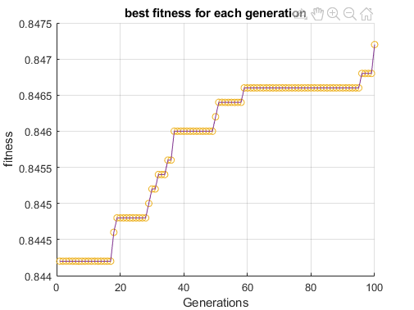
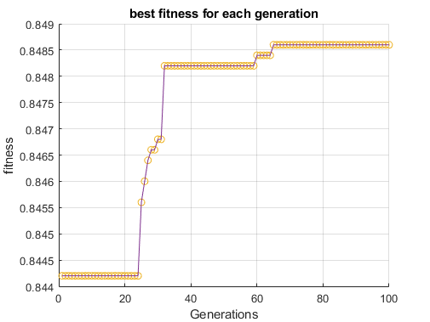
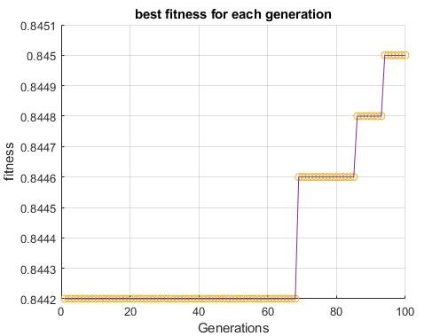
Same as previous but amount mutated = 5%
Looks like if it continued it would get better
Same as previous but amount mutated = 0.1%
Increased even more and faster than previous
Same as previous but amount mutated = 0.001%
Increased even more and faster than previous took longer but was the best again.

Slide 5
Some notes:
Training the 10 models (1 by 1) resulted in cpu usage of ca. 20-40%
Running the genetic algorithm results in cpu usage of ca. 14-20%
(all on my computer so numbers may very)
Reducing the amount of mutation dramatically decreases the time between each generation and increases performance

Slide 6
10 models trained using 3 epochs
Sticking with 0.1% amount mutated and mutation rate of 0.11

Slide 7
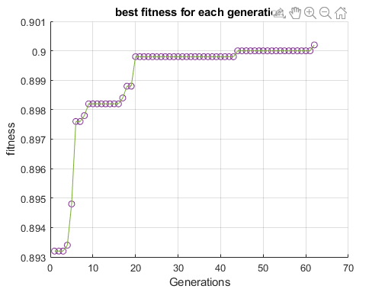


3 epochs; 10 models; 100 generations
Mutation rate: 0.11
Mutation amount: 0.1%
Really good results!!!: need broke out early because of end criteria

Slide 8
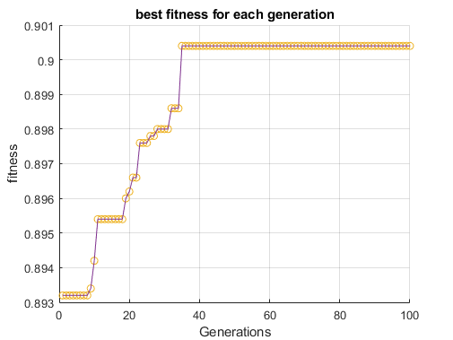


3 epochs; 10 models; 100 generations
Mutation rate: 0.11
Mutation amount: 0.1%
Really good results!!!: without breaking out. Seems to get caught in local minimum

Slide 9
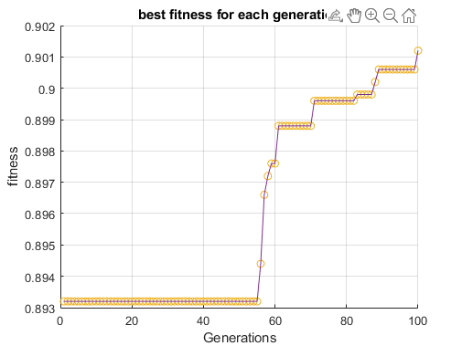


3 epochs; 10 models; 100 generations
Mutation rate: 0.2
Mutation amount: 0.1%
Higher mutation rate took much longer to leave local optimum. (over 50 generations)

Slide 10
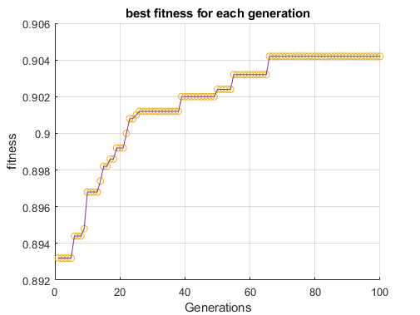


3 epochs; 10 models; 100 generations
Mutation rate: 0.15
Mutation amount: 0.1%
Best one so far. Starts off strong then gets caught about about generation 65 or so.

Slide 11
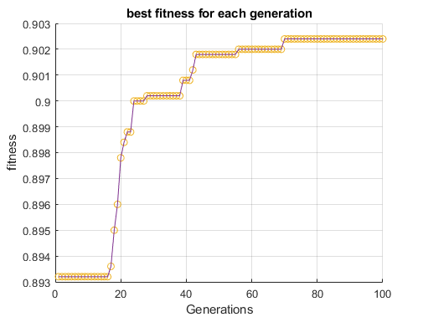


3 epochs; 10 models; 100 generations
Mutation rate: 0.165
Mutation amount: 0.1%
Seems to have gotten caught at a lower accuracy

Slide 12
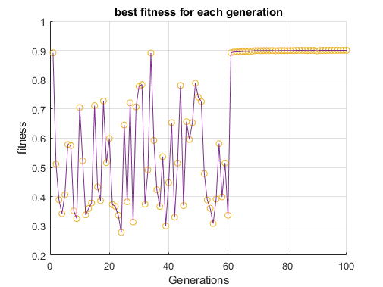

Same criteria as previous only looking at the median fitness model and 0.16 mutation rate
Mutation rate: 0.16
Maybe a better representation of crossing, mutation and getting caught in local optima?

Slide 13
1000 generations; epochs 3;

Slide 14
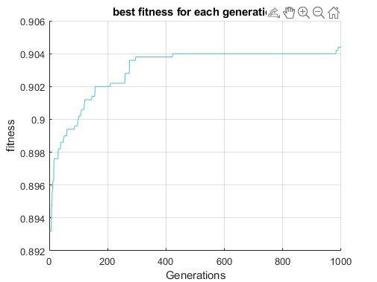
Mutation rate: 0.15

Slide 15
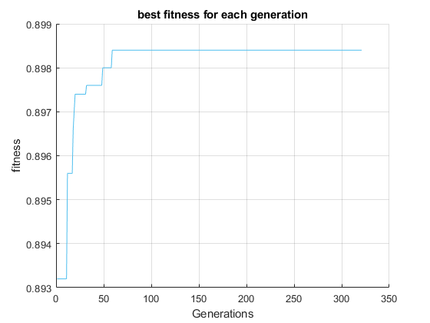
500 generations; 0.11 mutation rate; 10% mutation amount
Weight range = [-180, 180]/1000
Bias range = [-100, 200] /1000

Slide 16
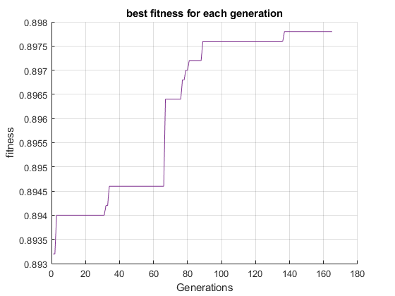
0.15 mutation rate; 1% mutation amount
Weight range = [-200, 200]/1000
Bias range = [-100, 200] /1000

Slide 17
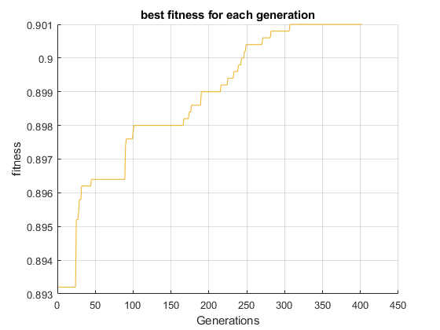
0.15 mutation rate; 1% mutation amount
Weight range = [-200, 200]/1000
Bias range = [-50, 150] /1000

Slide 18
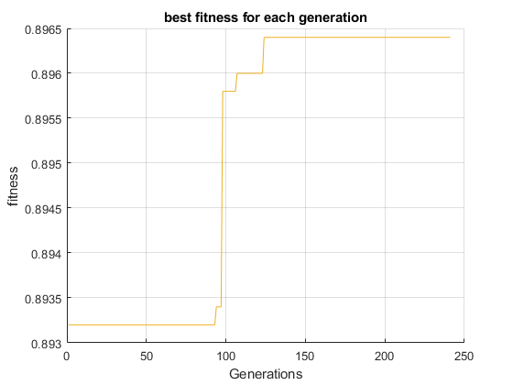
0.3 mutation rate; 1% mutation amount
Weight range = [-200, 200]/1000
Bias range = [-50, 150] /1000
Has some massive jumps but takes too long

Slide 19
More notes
It seems that often when a model becomes more fit it increases over 2 or so generations. If I were to guess. It would seem that when a mutation happens that is fitter, it then crosses and results in a better child. Also as the fitness goes up, the smaller the increase increments seem to be.

Slide 20
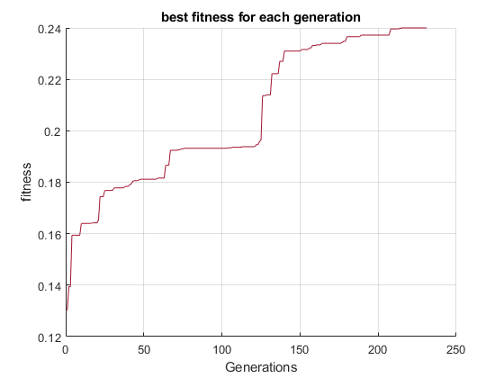
Lets try some untrained models (initialized with random weights)
0.3 mutation rate; 1% mutation amount
Weight range = [-200, 200]/1000
Bias range = [-50, 150] /1000
Over a % increase in just over 100 generations much better.

Slide 21
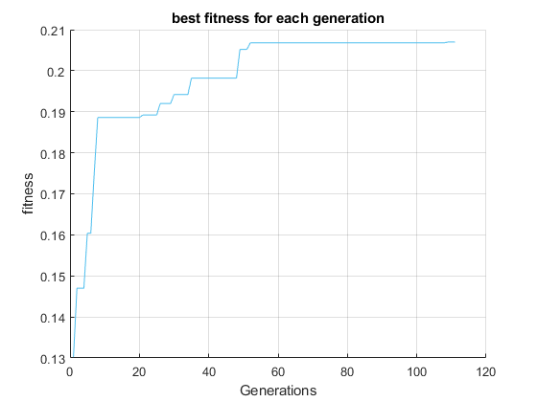
0.5 mutation rate; 1% mutation amount
Weight range = [-200, 200]/1000
Bias range = [-50, 150] /1000

Slide 22
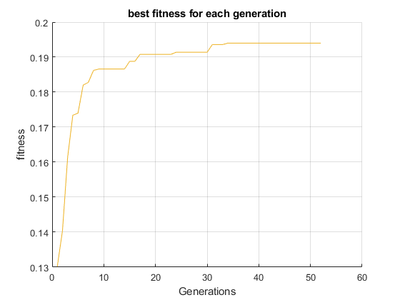
0.15 mutation rate; 1% mutation amount
Weight range = [-200, 200]/1000
Bias range = [-50, 150] /1000

Slide 23
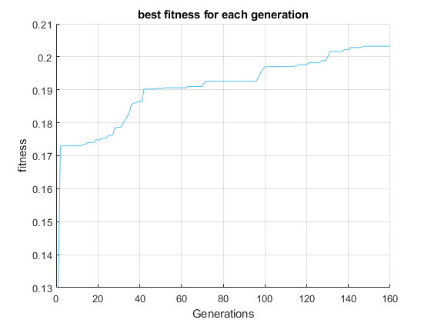
Parents 1:3 child 4:10
Mut rate 0.15
Mut amount: 1%

Slide 24
Trying 4 parents and randomly choosing 3 of them during crossover hopefully no errors….
Also trying with 10 models with 5 epochs so hopefully super high accuracy
An idea to improve the algorithm is to not use accuracy and use the loss that is already calculated? So use the genetic algorhmn in training could be quite cool
Okay so I tried with 4 parents, but it didn’t result in much. So reverted back to 2 parents
Result of 2 parents next slide. Mutation rate 0.15; 1% mutation amount;

Slide 25
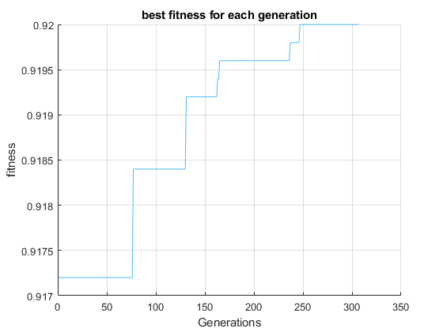

Slide 26
Changed it to 3 parents. The nchange the first line in child for loop from evoSandBox(1, hyperparameter) → evoSandBox(3, hyperparameter)
Lets see the result of that

Slide 27
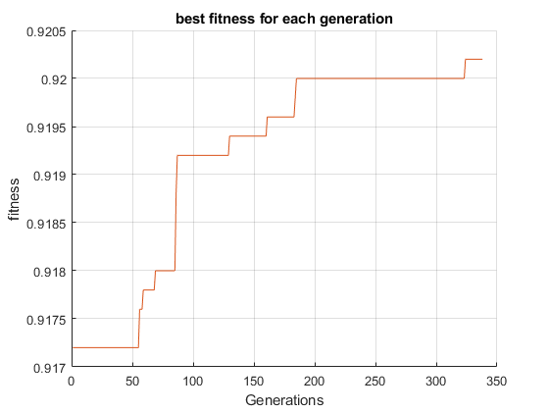
Literally the same as the last one but got lucky with how many generations it took to get there

Slide 28
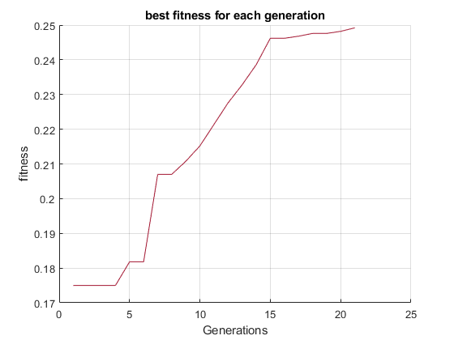
Trying 100 untrained models
Takes suuuuper long.
But gets just under 1% in just over 20 generations. But taking too long so I stopped:

Slide 29
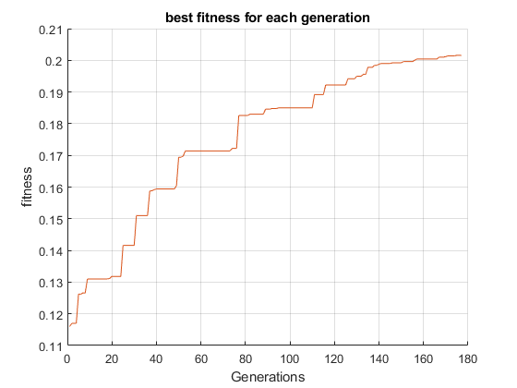
Lets try like 5 untrained models. Far more generations but took much less time

Slide 30
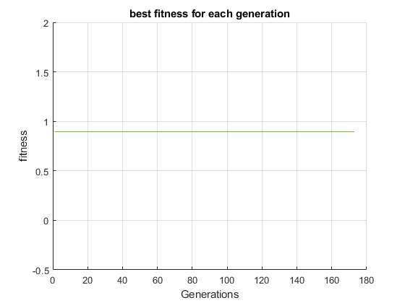
5 trained models (3 epochs)
Lets see what results we get. mAmount: 1%; rate: 0.15 same weight and bias range.
Doesn’t seem to increase… need more models I guess

Slide 31
To end off
Most consistent: parents =1:2
Child: 3:matrixnumber
First child is the same as best performing and then is crossed (as to not go index out of bounds), wheeloffortune has cosists of 3 models

Slide 32
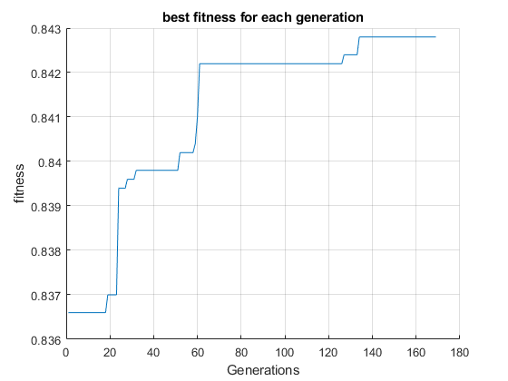
Last thing I tried was making it 2 values (not taking the child which is the same as the first parent). That seems to be working as well. But yeah none of them get very high percentages but it I believe we have created the genetic algorthmn to improve weights (albeit slightly xD)
Last thing I tried was making it 2 values (not taking the child which is the same as the first parent). That seems to be working as well. But yeah none of them get very high percentages but it I believe we have created the genetic algorthmn to improve weights (albeit slightly xD)
0.11 mutation rate

Slide 33
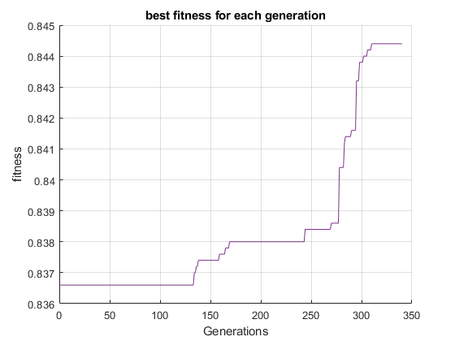
Mutation rate 0.15 – gives some big jumps but took like 200 generations to start moving

